Slide 1
IAF and ISO/CASCO Activities
Presenter: Baskar Kotte
March 19, 2015

Slide 2
IAF: International Accreditation Forum

Slide 3
IAF Organizational Structure
Board of Directors
MLA Committee
Technical Committee
Development support Committee
Executive Committee
IAF Members
secretary
Communications & Marketing committee
End user advisory committee

Slide 4
IAF Members
Albania | Czech Republic | Indonesia | Norway
Albania | Ecuador | Kenya | Russian Federation
Argentina | Egypt | Kazakhstan | Serbia
Australia & New Zealand | Finland | Korea | Singapore
Austria | France | Kosovo | Slovakia
Belgium | GCC Economies | Luxembourg | Slovenia
Brazil | Germany | Malaysia | South Africa
Canada | Greece | Mauritius | Spain
Chile | Hong Kong, China | Mexico | Sweden
China | Hungary | Netherlands | Switzerland
Chinese Taipei | India | Norway | Thailand
Costa Rica | Indonesia | Pakistan | Tunisia
Colombia | Iran | Peru | Turkey
Czech Republic | Ireland | Philippines | United Kingdom
Denmark | Italy | Poland | United States of America
Dubai (UAE) | Japan | Portugal
 |  | Romania

Slide 5



Leadership
Chairman Randy Dougherty |  | Vice Chairman Xiao Jianhua
 | Secretary Elva Nilsen

Slide 6
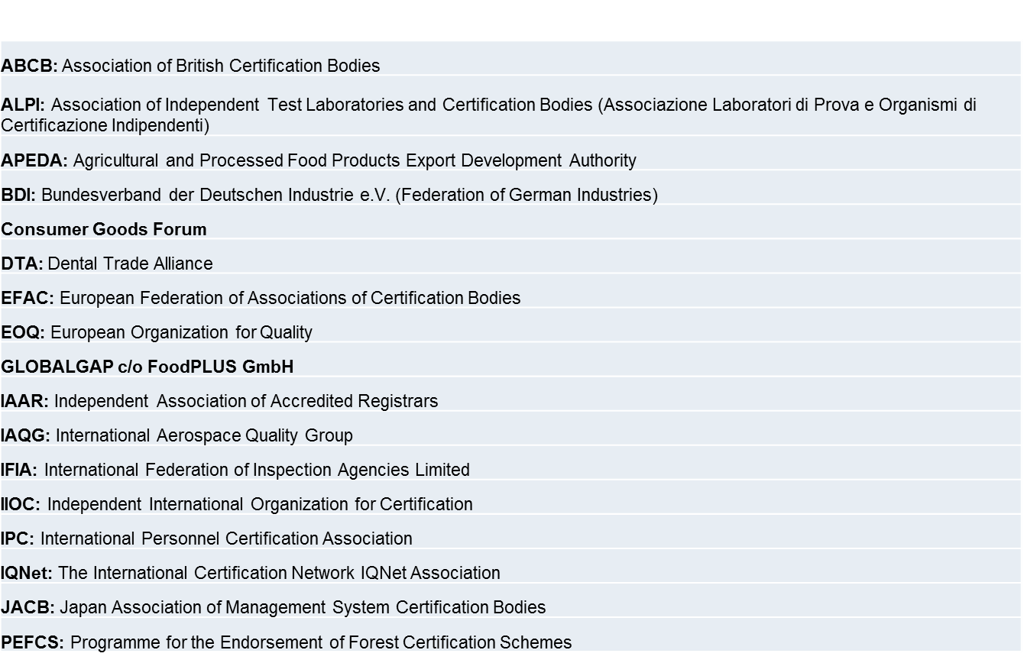
IAF Association Members

Slide 7
IAF Liaison Members
ISO/CASCO Liaisons | ISO/CASCO Liaisons
JTC 1/SC 7 | TC 176/SC 3
JTC 1/SC 27 | TC 207
TC6/TC 34 | TC 207/SC 1
TC 34/SC 17 | TC 207/SC 2
TC 46/SC 11 | TC 207/SC 7
TC 69 | TC 212
TC 85 | TC241/TC 242
TC 108/SC 5 | TC 276
TC135 | TC292
TC 135/SC7 | PC248/PC251
TC 176 | PC278
TC 176/SC 1/SC2 | COPOLCO/DEVCO/REMCO

Slide 8
IAF Organizations in Liaison
BIPM | INLAC
CAC | IPC
CEOC | IQ Net
EFAC | ITU
EOQ | NCSLI
EUROLAB | OIE
IFAN | OIML
IFIA | Qu EST Forum
IIOC | UILI
ILAC | UNFCCC

Slide 9
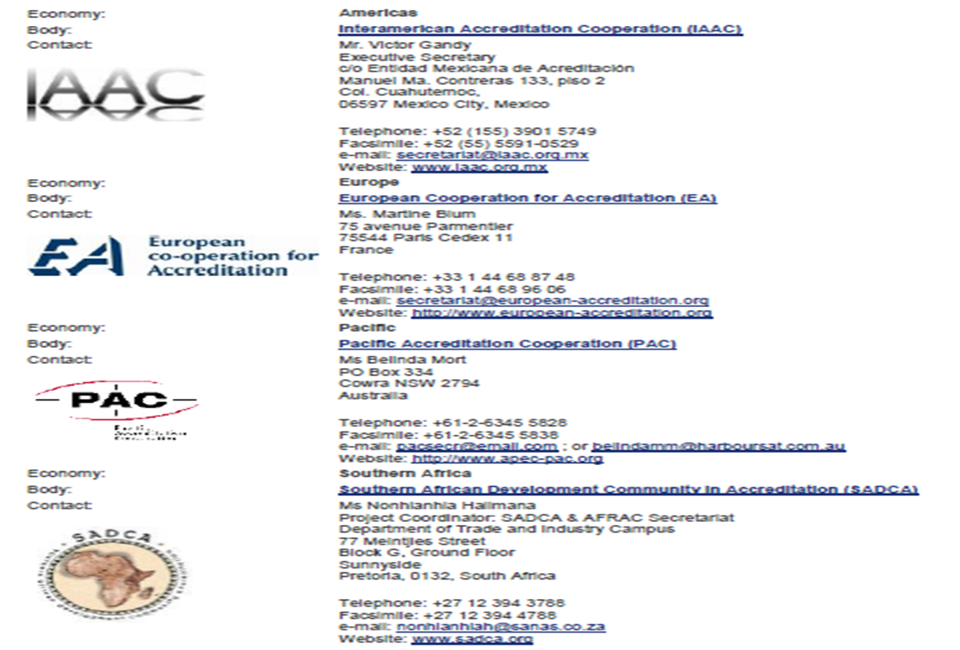
IAF Regional Accreditation Groups

Slide 10
IAF Committee Chairs
  V Anderson Chair: Financial Oversight Committee
  Dr. T Facklam Chair: Executive Committee/ Board of Directors IAF.
  J Brough-Kerrebyn & Dr. L Thione Vice Chairs:
  Xiao Jian Hua Chair:(MLA ) Multilateral Recognition Agreement
  R. Dougherty Chair Technical Committee Task Force and Groups.
  B. Mutabazi Chair: Development Support Committee (DSC)

Slide 11
IAF Publications
The publications section provides information on IAF publications and Auditing Practices Groups. The publications include:
Policy Documents (PL Series): IAF Policy documents set out the policies, including governance requirements that IAF members are expected to follow as well as statements of the IAF viewpoint on current issues.
Multilateral Recognition Arrangement (MLA) Documents - (ML Series): The primary purpose of IAF is to establish Multilateral Recognition Arrangements (MLA) between its accreditation body members in order to contribute to the freedom of world trade by eliminating technical barriers to trade.
IAF Guidance Documents (GD Series): IAF also publishes Guidance for the use of accreditation bodies when accrediting certification/registration bodies to assure that they also operate their programs in a consistent and equivalent manner.
IAF Informative Documents (ID Series): IAF Informative Documents reflect the consensus of IAF members on this subject and are intended to support the consistent application of requirements.

Slide 12
IAF Publications (Cont'd.)
IAF Mandatory Documents (MD Series): IAF publishes Mandatory Documents which are required to be used by accreditation bodies when accrediting certification/registration bodies to assure that they operate their programs in a consistent and equivalent manner.
Procedures Documents (PR Series): IAF Procedures documents lay down the procedures to be followed in implementing the IAF program, spelling out the procedures and processes which must be followed in order to satisfy the IAF Objectives, Certificate of Incorporation and Bylaws.
IAF-ILAC Joint Publications (A Series): Joint IAF and ILAC documents used for the evaluation of regions, unaffiliated bodies and inspection bodies.
Accreditation Auditing Practices Group (AAPG) Documents: The AAPG has prepared a number of papers and presentations on accreditation auditing practices, against the International Standards and Guides produced by ISO/CASCO.

Slide 13
IAF Publications (Cont'd.)
ISO 9001 Auditing Practices Group (APG) Documents: The APG has prepared a number of papers and presentations on auditing QMSs.
Documents for General Information: This page contains a number of IAF documents which are made available publicly for information to assist people interested in understanding IAF and its operations.
Promotional Documents: A range of resource materials promoting accreditation and accredited certification will be added to this page as they become available. These are for use by IAF members, their accredited certification bodies and other stakeholders interested in accreditation.

Slide 14
Resolutions at IAF
IAF Twenty-Eighth Annual General Assembly-Vancouver, Canada
A total of 25 Resolutions were adopted

Slide 15
Connected Highlights of the Resolutions
IAF Resolution 2014–11 – (Agenda Item 8)
ISO 14001: 2015: EMS Environmental Management Systems – Requirements with guidance for use –
The General Assembly, acting on the recommendation of the Technical Committee, resolved to endorse ISO 14001: 2015 as a normative document.
The General Assembly further agreed that the transition period of ISO 14001: 2015 will be three years from the date of publication.

Slide 16
IAF TRANSITION GUIDANCE
Evaluation During DIS Stage Cannot be Considered as Formal Transition Process.
Any Early Evaluation Must be Re-assessed Prior to Transition Audit
Lack of Conformance to New Requirements Should be Treated as Documented Findings.
ISO 9001:2015 Certification Only After QMS Demonstrated Effectiveness.
Conformance to ISO 9001:2008 Should be Maintained During Transition Phase.

Slide 17
Who Can Benefit From This Guidance
Organizations certified and/or using
ISO 9001:2008.
Accreditation Bodies (ABs).
Certification Bodies (CBs).
Training bodies and consultants

Slide 18
Organizations Using ISO 9001:2008
Identify Gaps to Address New Requirements.
Develop an Implementation Plan.
Provide Appropriate Training and Awareness
Update the Existing Quality Management System (QMS) to Meet all Requirements.
Interface with Certification Body for Transition
Plan and Schedule the Assessment and Accreditation Decision.

Slide 19
Certification Bodies
Train Auditors to Demonstrate Competence
Inform CBs about IAF Transition Guidance Documents
Communicate With Accreditation Bodies, National Standards Bodies and Other Certification Bodies as Needed..
Ensure the Stated Transition Period and Current Certification Period.
Encourage Current Users of ISO 9001:2008 to Start the Implementation of ISO 9001:2015 at an Early Stage, Recognizing Potential Changes can Occur During the DIS Stage.
Encourage new users to implement ISO 9001:2015.
Arrange audit schedules for Existing Client Organizations.

Slide 20
Accreditation Bodies
Inform CBs about IAF Transition Guidance Documents.
Plan Resources for Training Auditors to Demonstrate Competence.
Ensure the Criteria Used to Assess Auditor Competence are Adequate to Verifying Conformance to the Revised Standard.
Train Assessors to Ensure the Relevant Level of Competence is Demonstrated.
Communicate with Accredited Certification Bodies, National Standard Bodies and Other Accreditation Bodies as Needed.
Plan Schedules,Timings of Assessments and Determine Assessment Dates.
Plan the Timing of Accreditation Decisions for Upgrading Accreditation Certificates.

Slide 21
NABCB Expels 2 Companies : Hmmmm !
NABCB- National Accreditation Board for Certifying Bodies- INDIA has cancelled accreditation of two certification bodies dealing with ISO 9001 certification for unethical practices.
In yet another action,
NABCB Withheld Re-accreditation of two Certification Bodies for QMS and EMS Certification for not Meeting Accreditation Norms.
NABCB Decided to Engage Private Detective Agencies to Investigate Potential Unethical Activities in the Certification Process

Slide 22
Schedule of Next Meetings
The Joint IAF-ILAC Mid-term Meetings will be held in Frankfurt, Germany from 09 - 16 April 2015.
The next IAF/ILAC joint meetings will be the IAF-ILAC Joint Annual Meetings held from 28 October – 06 November, 2015 in Milan, Italy.

Slide 23
ISO/CASCO: Committee on
Conformity Assessment

Slide 24

Leadership
ISO CASCO Chairman: Mr. Lane Hallenbeck
 | Secretary Sean MacCurtain. Geneva

Slide 25
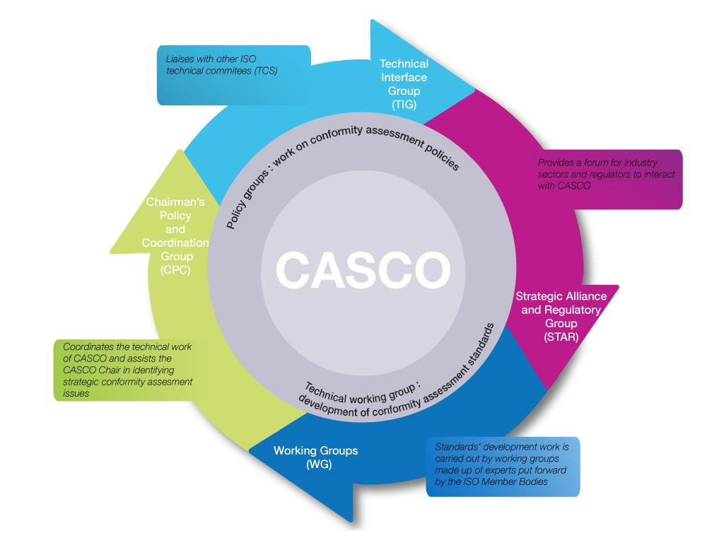
Objectives and Structure of CASCO

Slide 26
ISO – A Global System
162 National Members
98% of World GNI
97% of World Population
Collection of 19 777
ISO Standards
Vision & Strategy
Customer
Internal Processes
Learning Growth
Financial
Over 649
Organizations
in Liaison
1 103 standards
produced in 2013
229 Active TGs
3483 Technical Bodies
4518 Documents Under development
Central Secretariat In Geneva
138 FTE Staff from 19 Countries

Slide 27
Different Types of International Standards Efficiently Addressing Global Challenges
Social
responsibility
ISO 26000
Core subjec
.
Conformity
Assessment
Practices: test,
inspect, certify
Energy
management
ISO 50001
Specification Measurement Assessment Process Mgmnt/Leadership
Water quality,
metering,
treatment
services
GHG
measurement
ISO 14064/65
Plastics
composting and
biodegradation
measurement

Slide 28
ISO/CASCO Membership & Structure
COMMITTEE ON
CONFORMITY
ASSESSMENT
124 ISO Members
19 International Organizations in Liaison
Policy and Technical Work
Continual Improvement and Feedback Cycle

Slide 29
CASCO Recently Published Documents
ISO/IEC DTS 17021-4 Part 4: Competence Requirements – Event Sustainability MS
ISO/IEC DTS 17021-5 Part 5: Competence Requirements -Asset MS
ISO/IEC TS 17021-7 Competence Requirements -Certification of Road Traffic Safety MS
ISO/IEC DTS 17027 Terminology Related to Competence -Certification of Persons
ISO TS 22003 Requirements for bodies providing audit and certification of Food Safety MS

Slide 30
CASCO Documents Under Development
ISO/IEC 17021-1 Requirements for bodies providing audit and certification of MS
ISO/IEC TS 17021–6 Competence requirements -certification of business continuity MS
ISO/IEC 17026 Example of a product certification scheme

Slide 31
ISO Accredited Certificates as of 2013
 | Certificates | Countries | Growth
ISO 9001 Requirements for Quality Management Systems | 1’129’446 | 187 | 3%
ISO 14001 Requirements for Environmental Management Systems | 301’647 | 171 | 6%
ISO/IEC 27001:2005 Requirements for Information Security MS | 22 293 | 105 | 14%
ISO/TS 16949:2009 Requirements for The Application of ISO 9001:2008 By Suppliers in The Automotive Sector | 53 723 | 84 | 7%
ISO 13485:2003 Quality Management Requirements for the Medical Devices Sector for Regulatory Purposes | 25 666 | 85 | 15%
ISO 22000:2005 Requirements For Food Safety MS | 26 847 | 142 | 15%
ISO 50001:2011 Requirements For Energy MS | 4 826 | 78 | 116%

Slide 32

CASCO Recently Approved Projects
Revision of ISO/IEC 17011 Requirements for accreditation bodies (1st meeting November 2014)
REMCO and CASCO to transform ISO Guide 34 General requirements for the competence of reference material producers into an IS following REMCO plenary meeting resolution.
Revision of ISO/IEC 17025 General requirements for the competence of testing and calibration laboratories (1st meeting February 2015)

Slide 33
ISO Future Events
  16 SEPTEMBER 2015 - 18 SEPTEMBER 2015
38th ISO General Assembly Seoul, Republic of Korea. ISO's annual meeting for members and their stakeholders
12 MAY 2015 - 14 MAY 2015
ISO COPOLCO Plenary Meeting 2015 Geneva, Switzerland Annual meeting, workshop and related events

